Slide 1
Work ENVIRONMENT
State Polytechnic of Malang

Slide 2
COMPETENCY
Students know the legal foundation of the Work Environment Health Requirements, and understand what is meant by the Physical and Non-Physical Work Environment.

Slide 3
PHYSICAL
Physical Direct
NON-PHYSICAL
Employee relations at workplace
Physical Intermediaries:
Lighting / Light
Temperature
Humidity
Air Circulation
Noise
Mechanical vibration
Smells
Color arrangement
Decor
Music
Security
Task structure
Employee relations outside the workplace
Job design
Leadership pattern
Pattern of cooperation
Availability
Working facilities
Reward

Slide 4
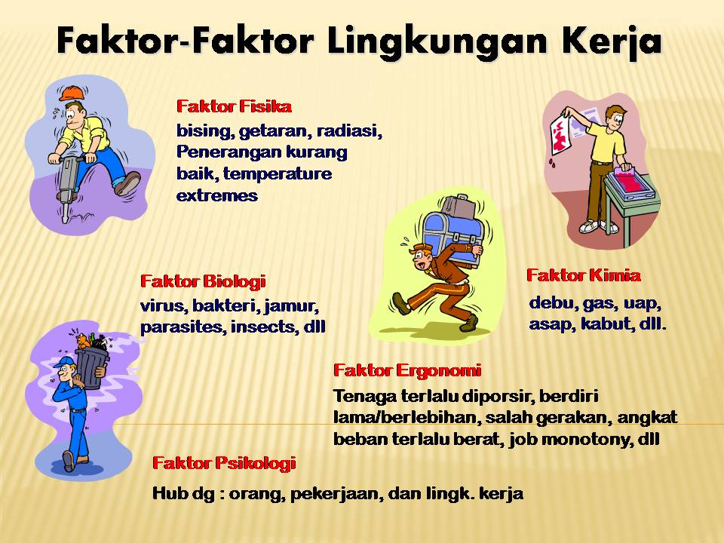

Slide 5
preliminary
Cikmat (in Nawawi, 2003:292)
“The work environment is a set of characteristics of working conditions that can be measured based on the shared perception of organizational members who live and work together in an organization”
Lussier (in Nawawi, 2003:293)
“The work environment is a relatively continuous internal quality of the organization that is felt by its members”.
Sedarmayanti (2001:1)
“The work environment is the overall tools and materials encountered, the surrounding environment in which a person works, his work methods, and work arrangements both as individuals and as a group..

Slide 6
preliminary
Work environment is a place where the members of the organization carry out their work and a working condition that can be measured based on the shared nature and subjective perceptions of its members who live and work together which lasts continuously and produces memorable actions in carrying out their duties and work.

Slide 7
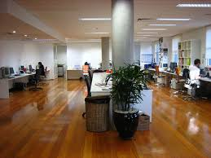
Physical work environment

Slide 8
Physical work environment
Sedarmayanti (2001:21)
“Physical work environment is all physical conditions that exist around the workplace that can affect employees both directly and indirectly”
Physical work environment is divided into two categories:
Direct Physical Work Environment
Intermediary Physical Work Environment

Slide 9
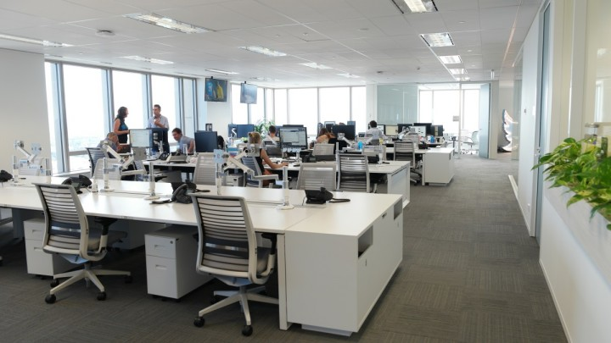
Direct Physical Work Environment
The environment that is directly related to employees such as: work center, chairs, tables and so on.
Direct physical working environment is related to the condition of the building area and the existing equipment, which is part of a tool for employees.

Slide 10
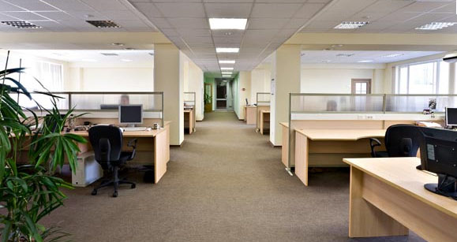
Health Requirements Office, Room and Building Work Environment for workspace must meet:
Strong building, well-maintained, clean and not allow the occurrence of health problems and accidents.
The floor is made of strong material, waterproof, flat surface, not slippery and clean.
Each employee has a minimum air space of 10m3 / employee.
Clean and brightly colored walls. Wall surfaces that are always exposed to water splashes are made of water-resistant material.

Slide 11
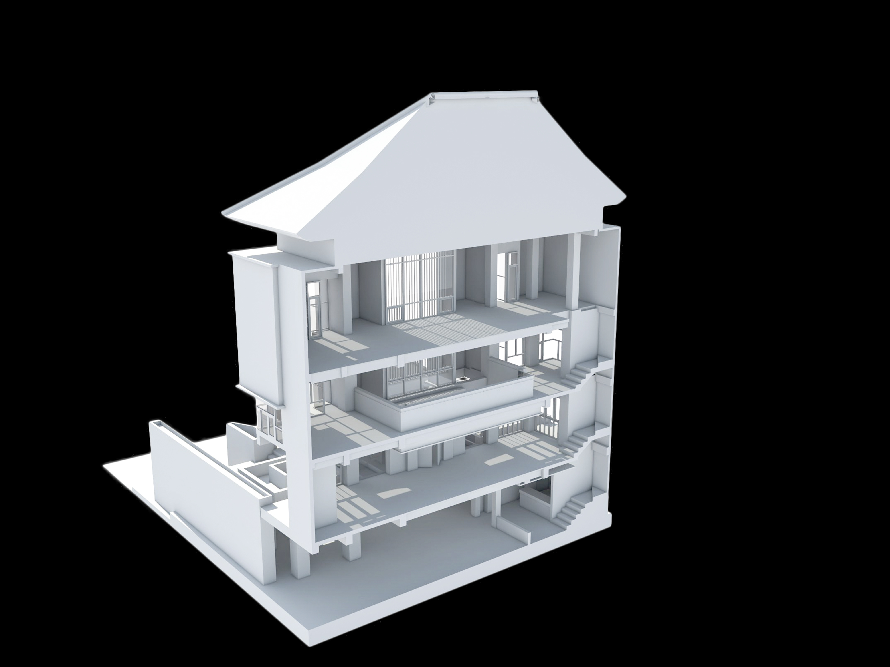
Health Requirements Office, Room and Building Work Environment for workspace must meet:
The ceilings are strong, clean, bright, minimal height of 2.50 m from the floor.
Strong and no leaking roof.
Spacious windows, grille or wall glass for the inclusion of at least 1/6 times the light of a floor area.

Slide 12
Intermediaries working environment

Slide 13
Intermediaries working environment
Lighting / Light in the Workplace
Temperature at work
Humidity in the Workplace
Air Circulation at Work
Noise at Work
Mechanical Vibration at Work
Smell at Work
Coloring at Work
Decoration at Work
Music at Work
Workplace Security

Slide 14
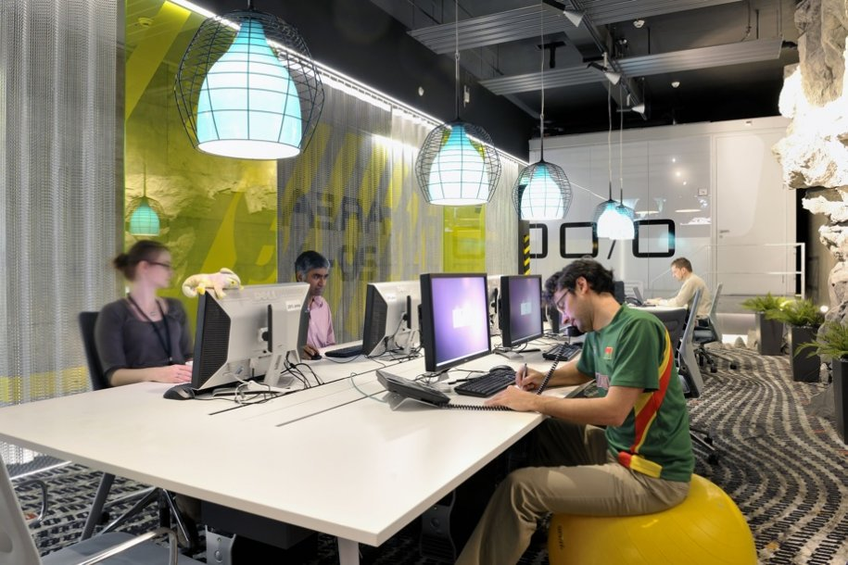
Lighting / Light in the Workplace
Light or lighting is very beneficial for employees in order to get safety and smooth work.
Based on the decision of the minister of health No. 261 / MENKES / SK / II / 1998 concerning: Health Requirements for Office Work Environment, Light intensity in a workspace of at least 1000 Lux in an average measurement of 8 hours

Slide 15
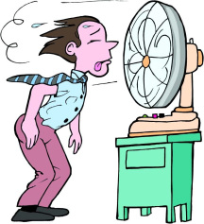
Temperature at work
Under normal circumstances, each member of the human body has a different temperature.
Based on the decision of the minister of health No. 261 / MENKES / SK / II / 1998 concerning: Health Requirements for Office Work Environment, the temperature in the workspace is at least 18⁰C and a maximum of 26⁰C.

Slide 16

Humidity in the Workplace
The amount of water contained in air, usually expressed in percentages.
Influenced by air temperature, and together between temperature, humidity, speed of moving air and heat radiation from the air will affect the state of the human body when receiving or releasing heat from the body.
Based on the decision of the minister of health No. 261 / MENKES / SK / II / 1998 concerning: Health Requirements for Office Work Environment, Humidity in the workspace of at least 40% and a maximum of 60%.

Slide 17
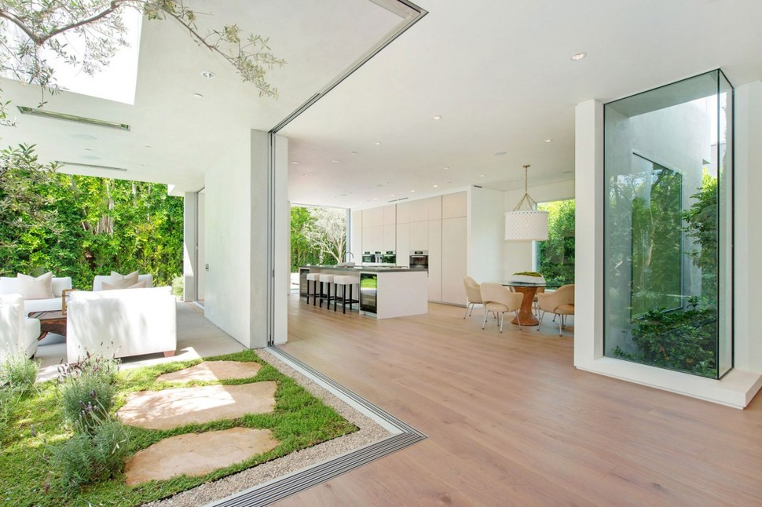
Air Circulation at Work
Oxygen is a gas that is needed by living things to sustain life, for metabolic processes.
Based on the decision of the minister of health No. 261 / MENKES / SK / II / 1998 concerning: Health Requirements Office Work Environment, Air Circulation in the workspace 0.283 m3 / minute / person with a ventilation rate: 0.15 - 0.25 m / sec.

Slide 18

Noise at Work
One of the pollution that is quite busy for experts to overcome it is noise, which is the sound that is not desired by the ear.
There are three aspects that determine the quality of a sound, which can determine the level of disruption to humans, namely:
Duration of noise
Intensity of noise
Frequency of noise

Slide 19
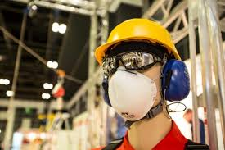
Noise at Work
Based on the decision of the minister of health No. 261 / MENKES / SK / II / 1998 concerning: Health Requirements of Office Work Environment, Room noise level in the workspace is a maximum of 85 dB in an average measurement of 8 hours.

Slide 20
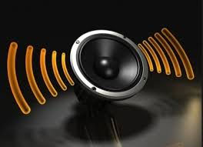
Mechanical Vibration at Work
Mechanical vibration means the vibration caused by mechanical devices, most of these vibrations to the body of employees and can lead to unwanted consequences.
mechanical vibration can interfere with the body in terms of:
concentration of work
Fatigue comes
The emergence of several diseases, including due to disorders of: eyes, nerves, blood circulation, muscles, bones, and others, others.

Slide 21

Smell at Work
The presence of smells around the workplace can be considered as pollution, because it can interfere with work concentration, and odors that occur continuously can affect olfactory sensitivity.
The proper use of "air condition" is one way that can be used to eliminate disturbing odors around the workplace

Slide 22
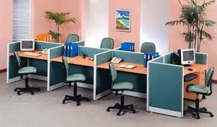
Coloring at Work
Arranging colors in the workplace needs to be studied and planned as well as possible.
The color can not be separated from the decoration arrangement. This is understandable because color has a great influence on feelings.
Characteristic and influence of color sometimes causes feelings of pleasure, sadness, etc., because in color can stimulate human feelings.

Slide 23
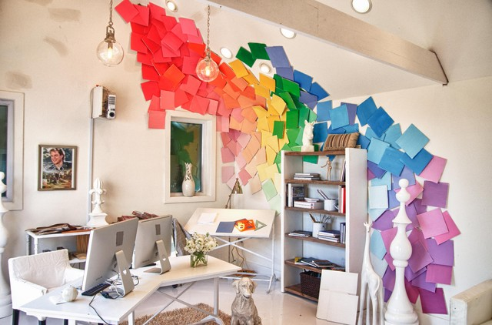
Decoration at Work
There is a relationship between decoration with a good color, therefore decoration is not only related to the results of the workspace but also related to the arrangement of layout, color, equipment, and others to work.

Slide 24

Music at Work
According to experts, music that has a soft tone in accordance with the atmosphere, time and place can arouse and stimulate employees to work.
Therefore, songs need to be selected selectively to be announced at work.

Slide 25

Workplace Security
In order to keep the place and condition of the work environment in a safe condition, it is necessary to note its existence.
One of the efforts to maintain security at the workplace, can utilize the power of the Security Officer Unit (SATPAM).

Slide 26
assignment
Make TTS (crossword puzzles) related to the physical work environment
The task consists of:
1 group consists of 5-6 people
There is a TTS column in an empty condition
Questions from TTS
Answer from TTS
10 questions about TTS

